Slide 1

Proposed Recommendations for the impact of Covid 19 on UK Healthcare service delivery: Local contextual Perspectives of Health care delivery
IMPACT ON COMMUNITY
Week 6

Slide 2
Aim:
To explore how Covid 19 can be implemented to achieve appropriate results yet minimises disruptions to healthcare services provision
Learning Outcomes:
At the end of this session , students will be able to:
Evaluate the impacts of Covid 19 on the health and care system’s using the community health services as a Local key perspective
Hypothesize potential outcome by putting forward recommendations for the impact of Covid 19 on community health services delivery

Slide 3

LO2 Activity (5 Minutes)
Individually, research the impacts of Covid 19 on the health and care system’s using the community health services as a Local key perspective.
Feedback by explaining your findings

Slide 4

The impacts of Covid 19 on Community health services
Community health services entered the COVID-19 pandemic at a time of significant challenge. Demand for care in the community outstripped capacity largely due to a growing and ageing population and an increasing number of people living longer with complex health needs.
This was exacerbated by funding constraints on the NHS and local authorities and workforce pressures, including shortages in several key professions.
The community sector is more vulnerable than other parts of the NHS to the disruption wrought by repeated re-tendering of services.
It seeks to learn from community providers’ experiences of the pandemic to secure much-needed transformation for the longer term and makes a number of recommendations for support from government and the national NHS bodies to enable this.

Slide 5

Support and Protect Health Services
It is important to support and protect health services so that they can cope with COVID-19, deliver routine care, and manage the significant morbidity from long COVID.
Reducing community transmission will be critical for this, but after a decade of underfunding and a huge hit from the pandemic, health services need urgent financial support, adequate personal protective equipment, and measures to increase staff recruitment and retention
Drawing on general practice and community services staff and expertise, including
Advanced nurse practitioners,
clinical pharmacy,
Social prescribing link workers,
Dental care, and wider specialist services (eg geriatrician and dementia services) where appropriate

Slide 6

Support and Protect Health Services (Cont…)
As the NHS works out how to restart routine services with the ongoing risk of outbreaks, primary care will be put under additional strain by delayed presentations, investigations, and treatment;
Poorly controlled long term conditions; a rise in mental illness;
The need to deliver the largest flu vaccination campaign to date; the effects of “long Covid”; and widened socioeconomic inequalities due to covid-19 and the associated response.
General practices, particularly smaller ones, will face workforce shortages as staff have to shield, intermittently self-isolate, or fall sick.
The shift in general practice to total triage and remote consulting may help service recovery, but remote consultations can pose their own risks to patient care and, where needed, any face-to-face care will be slowed by tight infection control measures in often ill-suited premises.

Slide 7

Care of residents in a care home during COVID-19
Care homes are a vital part of our health and social care system and we want to make sure you and your staff can continue to care for some of the most vulnerable to coronavirus (COVID-19) in our society.
To support care home providers to protect their staff and residents, ensuring that each person is getting the right care in the most appropriate setting for their needs.
To do this care homes need to have access to the right knowledge, staff and resources, so they’re equipped to deliver care in this challenging time.

Slide 8
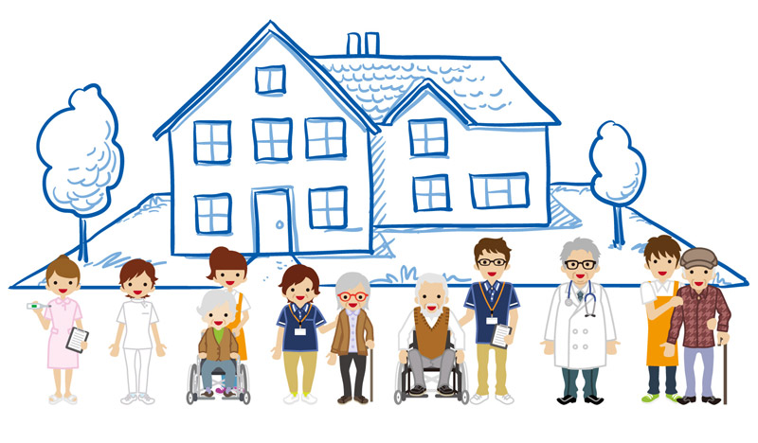
Care of residents in a care home during COVID-19
Delivery of a consistent, weekly ‘check in’, to review patients identified as a clinical priority for assessment and care.
Review patients identified as a clinical priority for assessment, including but not limited to those with suspected or confirmed COVID-19 symptoms, in line with the protocols established in the primary care standard operating procedures and the community services standard operating procedures
Support the provision of care for those patients identified as a clinical priority
Include appropriate and consistent medical oversight and input from a GP and/or geriatrician (with the frequency and form of that input determined by clinical judgement)

Slide 9
Care of residents in a care home during COVID-19
Support the introduction and use of remote monitoring of COVID-19 patients using pulse oximeters and other equipment (which may be supplied directly to care homes or eligible for practice reimbursement), and prescription and supply of oxygen to care homes for treatment, where clinically indicated and
Be supplemented by more frequent contact with the care home where further needs are identified.
Be supplemented by more frequent contact with the care home where further needs are identified

Slide 10

Reimbursement mechanism for general practice (GP)
Additional costs for general practices and community health services providers – which cannot be met from their existing resources – may be eligible for reimbursement.
A reimbursement mechanism for general practice will be established to help practices meet the additional costs of COVID-19 related activity which cannot be met from existing practice resources.
Reimbursement will be managed through CCGs, on the basis of national guidance

Slide 11

Isolation of residents during periods of sustained transmission
Due to evidence of asymptomatic spread, during periods of sustained transmission we recommend that all residents being discharged from hospital or interim care facilities to the care home and new residents admitted from the community should be isolated for 14 days within their own room.

Slide 12
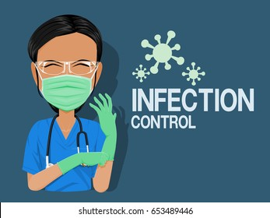
Infection prevention and control (IPC) measures
Care homes are not expected to have dedicated isolation facilities for people living in the home but should implement isolation precautions when someone in the home displays symptoms of COVID-19 in the same way that they would operate if an individual had influenza or diarrhoea and vomiting, taking the following precautions:
If isolation is needed, a resident’s own room can be used. Ideally the room should be a single bedroom with en-suite facilities. Where this is not available, a dedicated bathroom near to the person’s bedroom should be identified for their use only
PPE should be used when within 2 metres of a resident with possible or confirmed COVID-19. See guidance on PPE and guidance on working safely in care homes. Display signage to prevent unnecessary entry into the isolation room. Confidentiality must be maintained.

Slide 13


10 minutes break

Slide 14

Specific medical equipment
Dedicate specific medical equipment (for example, thermometers, blood pressure cuffs, pulse oximeters, etc) for residents.
Clean and disinfect equipment (including mobility aids) before re-use with another resident in accordance with manufacturer’s instructions, and where relevant return to the company for cleaning.
Particular attention should be paid to cleaning of any reusable equipment taken between the residents’ bedrooms
Where possible during outbreaks of COVID-19, use single-resident use devices such as blood pressure cuffs. Single-resident use equipment will be marked with a symbol depicting the number in a circle with a line through it.

Slide 15
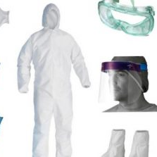
Personal Protective Equipment (PPE)
PPE is a key part of infection prevention and control.
Ensuring a supply of PPE to the adult social care sector is fundamental to protect care workers and allow them to continue to safely provide personal care for vulnerable individuals during this COVID-19 pandemic.
Ensure adequate appropriate supplies of PPE, cleaning materials, hand hygiene and respiratory hygiene materials, and waste disposal are available for all staff in the care home
All staff, including domestic cleaners, must be trained to understand how to use the PPE appropriate to their role to limit the spread of COVID-19.

Slide 16
Decontamination and cleaning processes for care homes with possible or confirmed cases of COVID-19
Domestic staff should be advised to clean the isolation room(s) after all other unaffected areas of the facility have been cleaned.
Ideally, isolation room cleaning should be undertaken by staff who are also providing care in the isolation room.
The person responsible for undertaking the cleaning with detergent and disinfectant should be familiar with these processes and procedures

Slide 17

Communication
The care home has the primary responsibility for the safety of its staff and residents.
Display signs to inform of the outbreak and infection control measures. Examples can be found in PHE’s COVID-19 resource centre.
Provide ‘warn and inform’ letters to residents, visitors and staff if there’s a possible case of COVID-19 in the home.
Although the HPT will provide public health advice in response to an outbreak (including potential closure to new admissions), the care home management has the final responsibility to communicate information, including to staff and visitors and to implement infection control recommendations and any advice on closure to admissions from the HPT.

Slide 18
Core principles for safely reopening community facilities
Community facilities are used for a range of purposes, and relevant guidance on specific activities is signposted.
Anyone with control of non-domestic premises (such as a community centre, village or community hall) has legal responsibilities under health and safety law, and must take reasonable measures to ensure the premises, access to it, and any equipment or substances provided are safe for people using it, so far as is reasonably practicable.
However, there are general principles that managers of community spaces should follow in making their space COVID-19 secure, and safely re-opening for permitted activity.
core public health guidance regarding health, hygiene, and social distancing
safe workplace guidelines, to ensure employees are safe to return to work

Slide 19

Robust service to support patients affected by COVID-19
To bolster care in the community during their COVID-19 response local partners, including social care and charities,. they created a robust seven day 8am to 8pm service to support patients affected by COVID-19 directly or indirectly.
This service reduced acute bed occupancy to 50 per cent at the height of the pandemic’s first peak, as well as a sustained reduction in the number of medically fit patients waiting for discharge and over 21-day stranded patients.
Most patients have gone home with wraparound support. This was possible as staff and volunteers took on duties beyond their normal scope. For example, nursing services and therapists undertaking care visits.

Slide 20

COVID-19 risk assessment
To help decide which actions to take prior to re-opening the building for permitted activity, a COVID-19 risk assessment should be completed, taking account of the core guidance on social distancing and the points set out below.
This will be in addition to any risk assessment which is already in place for the community facility. See guidance on completing a risk assessment.
Social distancing and capacity
Measures should be in place to ensure all users of community facilities follow the guidelines on social distancing, including strict adherence to social distancing of 2 metres or 1 metre.

Slide 21
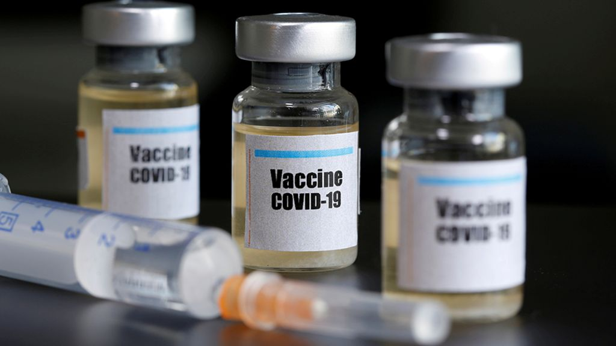
Vaccine surveillance strategy (Cont…)
This involves using existing disease surveillance systems and electronic health data, capturing vaccination data and active follow-up of vaccinated individuals and cases of COVID-19 within vaccine eligible cohorts.
With vaccines now being offered to several million people, comprehensive "real world" post-implementation surveillance systems are required to monitor delivery of the vaccination programme and evaluate its impact on health.
This involves using existing disease surveillance systems and electronic health data, capturing vaccination data and active follow-up of vaccinated individuals and cases of COVID-19 within vaccine eligible cohorts.

Slide 22

Adequate capacity to test, trace and quarantine
Testing of patients must be expanded, particularly for vulnerable patients such as those in residential and nursing care homes, and for patients who are accessing routine care (such as elective surgery) to provide confidence that areas designated for the care of non-Covid patients are not exposed unnecessarily to asymptomatic spread of Covid.
There must be strong focus on tracking and containing the virus in the community, and if local public health services are supported to lead this.
As the restoration of non-Covid services moves forward, the Government must put in place a credible and transparent strategy on testing. This should include, but not be limited to, continuing to increase national testing capacity.

Slide 23

Adequate PPE for health and care workers
Health care and other frontline workers have in a majority of cases not been supplied with the PPE they need to protect themselves and patients during the course of the outbreak.
A sufficient, guaranteed supply of PPE for healthcare workers to account for COVID-work, and for restarting non-COVID care with additional precautions in our “new normal” world, is essential.
For example, there will need to be sufficient PPE for staff use in general practice, outpatients and also for diagnostic, operating theatre, catheter laboratories and endoscopy suites.
There also needs to be appropriate PPE available (such as masks and eye protection) for patients using non-Covid services, to reduce the risk of transmission within the NHS.
There will need to be new or updated guidance on the appropriate PPE and infection control procedures that are relevant to the settings in which non-COVID treatment will take place.

Slide 24

Effective and transparent public communication (Cont.…)
Finally, we need clear and consistent public health messaging. The lack of this has allowed mistrust to thrive. The government needs to urgently restore public trust and confidence. It must reinstate daily briefings and be open, honest, and transparent about where we are.
It must admit to and learn from mistakes, not overstate its capabilities and achievements, and must treat the public as equal partners, working with communities to develop effective health promotion strategies.
The government must clearly communicate that protecting school education, routine health-care provision, and the economy are all inextricably tied to controlling COVID-19, and must stop conveying these as competing objectives.
Health services should be supported and protected so that they can cope with COVID-19, deliver routine care, and manage the significant morbidity from long COVID.

Slide 25


Permitted activities in multi-use community facilities: signposting to relevant guidance
Community facilities such as community centres and village halls are used for a wide range of local activities and services – from childcare provision to hosting social and recreational clubs.
Different activities are subject to specific reviews and guidance on when and how they are permitted to resume.
Where a premise delivers a mix of services, only those services that are permitted to be open should be available.

Slide 26
REFERENCE
England.nhs.uk. 2021. [online] Available at: <https://www.england.nhs.uk/coronavirus/wpcontent/uploads/sites/52/2020/03/COVID-19-response-primary-care-and-community-health-support-care-home-residents.pdf> [Accessed 25 February 2021].
Pettigrew, L., Kumpunen, S. and Mays, N., 2020. Primary care networks: the impact of covid-19 and the challenges ahead. BMJ, p.m3353.

